Slide 1
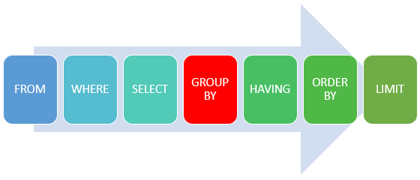

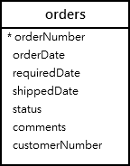
Grouping data
The GROUP BY clause groups a set of rows into a set of summary rows by values of columns or expressions. The GROUP BY clause returns one row for each group. In other words, it reduces the number of rows in the result set.
You often use the GROUP BY clause with aggregate functions such as SUM, AVG, MAX, MIN, and COUNT. The aggregate function that appears in the SELECT clause provides information about each group.
The GROUP BY clause is an optional clause of the SELECT statement. The following illustrates the GROUP BY clause syntax:
SELECT c1, c2,..., cn, aggregate_function(ci)
FROM table
WHERE where_conditions
GROUP BY c1 , c2,...,cn;
The GROUP BY clause must appear after the FROM and WHERE clauses. Following the GROUP BY keywords is a list of comma-separated columns or expressions that you want to use as criteria to group rows.
MySQL evaluates the GROUP BY clause after the FROM, WHERE and SELECT clauses and before the HAVING , ORDER BY and LIMIT clauses:
A) Simple MySQL GROUP BY example
Let’s take a look at the orders table in the sample database.
table orders
Suppose you want to group values of the order’s status into subgroups, you use the GROUP BY clause with the status column as the following query:
SELECT status
FROM orders
GROUP BY status;
As you can see, the GROUP BY clause returns unique occurrences of status values. It works like the DISTINCT operator as shown in the following query:
SELECT DISTINCT status FROM orders;

Slide 2


MySQL GROUP BY with expression example
In addition to columns, you can group rows by expressions. The following query gets the total sales for each year.
SELECT
YEAR(orderDate) AS year,
SUM(quantityOrdered * priceEach) AS total
FROM
orders
INNER JOIN orderdetails
USING (orderNumber)
WHERE
status = 'Shipped'
GROUP BY
YEAR(orderDate);
In this example, we used the YEAR function to extract year data from order date ( orderDate). We included only orders with shipped status in the total sales. Note that the expression which appears in the SELECT clause must be the same as the one in the GROUP BY clause.
GROUP BY with HAVING clause example
To filter the groups returned by GROUP BY clause, you use a HAVING clause. The following query uses the HAVING clause to select the total sales of the years after 2003.
SELECT
YEAR(orderDate) AS year,
SUM(quantityOrdered * priceEach) AS total
FROM
orders
INNER JOIN orderdetails
USING (orderNumber)
WHERE
status = 'Shipped'
GROUP BY
year
HAVING
year > 2003;

Slide 3
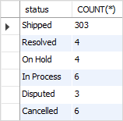

The GROUP BY clause: MySQL vs. standard SQL
MySQL also allows you to sort the groups in ascending or descending orders while the standard SQL does not. The default order is ascending. For example, if you want to get the number of orders by status and sort the status in descending order, you can use the GROUP BY clause with DESC as the following query:
SELECT
status,
COUNT(*)
FROM
orders
GROUP BY
status DESC;
Notice that we used DESC in the GROUP BY clause to sort the status in descending order. We could also specify explicitly ASC in the GROUP BY clause to sort the groups by status in ascending order.
[not supporting version8.0]
Standard SQL does not allow you to use an alias in the GROUP BY clause, however, MySQL supports this.
For example, the following query extracts the year from the order date. It first uses year as an alias of the expression YEAR(orderDate) and then uses the year alias in the GROUP BY clause. This query is not valid in standard SQL.
SELECT YEAR(orderDate) AS year,
COUNT(orderNumber)
FROM orders
GROUP BY year;
Every year how many order we received
Count order as per status of order ie. Shipped,on hold etc

Slide 4
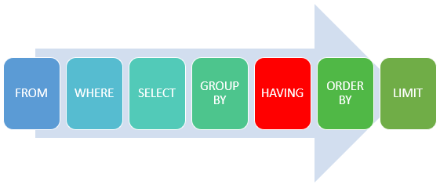
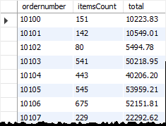
HAVING clause
The HAVING clause is used in the SELECT statement to specify filter conditions for a group of rows or aggregates.
The HAVING clause is often used with the GROUP BY clause to filter groups based on a specified condition. If the GROUP BY clause is omitted, the HAVING clause behaves like the WHERE clause.
The following illustrates the syntax of the HAVING clause:
SELECT select_list
FROM table_name
WHERE search_condition
GROUP BY group_by_expression
HAVING group_condition;
In this syntax, you specify a condition in the HAVING clause. If a row, which is generated by the group by clause, causes the group_condition to evaluate to true, the query will include it in the result set.
Notice that the HAVING clause applies a filter condition to each group of rows, while the WHERE clause applies the filter condition to each individual row.
MySQL evaluates the HAVING clause after the FROM, WHERE, SELECT and GROUP BY clauses and before ORDER BY, and LIMIT clauses.
Note that the SQL standard specifies that the HAVING is evaluated before SELECT clause and after GROUP BY clause.
HAVING clause examples
Let’s take some examples of using the HAVING clause to see how it works. We’ll use the orderdetails table in the sample database for the demonstration.
The following uses the GROUP BY clause to get order numbers, the number of items sold per order, and total sales for each from the orderdetails table:
SELECT
ordernumber,
SUM(quantityOrdered) AS itemsCount,
SUM(priceeach*quantityOrdered) AS total
FROM
orderdetails
GROUP BY ordernumber;

Slide 5
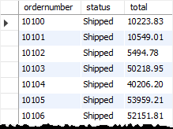
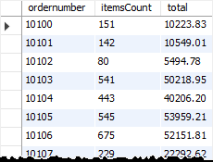
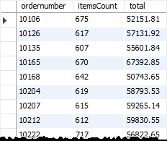
Now, you can find which order has total sales greater than 1000 by using the HAVING clause as follows:
SELECT
ordernumber,
SUM(quantityOrdered) AS itemsCount,
SUM(priceeach*quantityOrdered) AS total
FROM
orderdetails
GROUP BY
ordernumber
HAVING
total > 1000;
Suppose that you want to find all orders that are in shipped status and have the total amount greater than 1500, you can join the orderdetails table with the orders table using the INNER JOIN clause and apply a condition on status column and total aggregate as shown in the following query:
SELECT a.ordernumber, status,
SUM(priceeach*quantityOrdered) total
FROM
orderdetails a
INNER JOIN orders b
ON b.ordernumber = a.ordernumber
GROUP BY ordernumber,
status
HAVING status = 'Shipped' AND total > 1500;
You can construct a complex condition in the HAVING clause using logical operators such as OR and AND.
The following example uses the HAVING clause to find orders that have total amounts greater than 1000 and contain more than 600 items:
SELECT ordernumber,
SUM(quantityOrdered) AS itemsCount,
SUM(priceeach*quantityOrdered) AS total
FROM orderdetails
GROUP BY ordernumber
HAVING total > 1000 AND itemsCount > 600;
The HAVING clause is only useful when you use it with the GROUP BY clause to generate the output of the high-level reports. For example, you can use the HAVING clause to answer questions like finding the number orders this month, this quarter, or this year that have total sales greater than 10K.

Slide 6
Having can be used without groupby clause,in aggregate function,in that case it behaves like where clause. groupby can be used without having clause with the select
S.No. | Having Clause | GroupBy Clause
1. | It is used for applying some extra condition to the query. | The groupby clause is used to group the data according to particular column or row.
2. | Having can be used without groupby clause,in aggregate function,in that case it behaves like where clause. | groupby can be used without having clause with the select statement.
3. | The having clause can contain aggregate functions. | It cannot contain aggregate functions.
4. | It restrict the query output by using some conditions | It groups the output on basis of some rows or columns.
Difference between Having clause and Group by clause :
The HAVING clause was added to SQL because the WHERE keyword cannot be used with aggregate functions.

Slide 7
Can Having clause be used without Group by clause?..
Answer:
we can use, but select columns and having columns should use with aggregare functions
ex:
select max(empid), min(marks)
from employee
having max(empid_id)>100
select * from table where id = 1
select * from the table having id = 1
Notice that the MySQL HAVING clause applies the condition to each group of rows, while the WHERE clause applies the condition to each individual row.

Slide 8
Key Differences:
WHERE filters individual rows before grouping:
Applied at the row level before aggregation occurs.
Used to filter records before applying GROUP BY.
SELECT country, COUNT(*) FROM customers WHERE country != 'USA' GROUP BY country;
SELECT country, COUNT(*) AS customer_count
FROM customers
GROUP BY country
HAVING customer_count > 10;
HAVING filters grouped results after aggregation:
Applied after grouping, to filter aggregated results.
Used for conditions based on aggregate functions (COUNT, SUM, etc.).
Clause | Filters On | Works Before/After GROUP BY
WHERE | Individual rows | Before grouping
HAVING | Aggregated groups | After grouping
If you want to filter individual rows before aggregation, use WHERE. If you want to filter grouped results after aggregation, use HAVING.

Slide 9
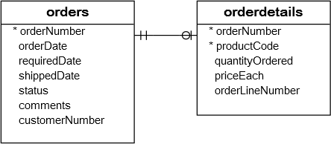
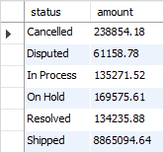
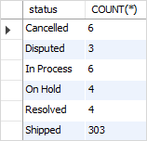
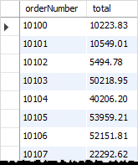
GROUP BY with aggregate functions
See the following orders and orderdetails table.
The aggregate functions allow you to perform the calculation of a set of rows and return a single value. The GROUP BY clause is often used with an aggregate function to perform calculation and return a single value for each subgroup.
For example, if you want to know the number of orders in each status, you can use the COUNT function with the GROUP BY clause as follows:
to get the total amount of all orders by status, you join the orders table with the orderdetails table and use the SUM function to calculate the total amount. See the following query:
SELECT status,
SUM(quantityOrdered * priceEach) AS amount
FROM orders
INNER JOIN orderdetails
USING (orderNumber)
GROUP BY status;
SELECT
status, COUNT(*)
FROM orders
GROUP BY status;
Similarly, the following query returns the order numbers and
the total amount of each order.
SELECT orderNumber,
SUM(quantityOrdered * priceEach) AS total
FROM orderdetails GROUP BY orderNumber;

